Slide 1
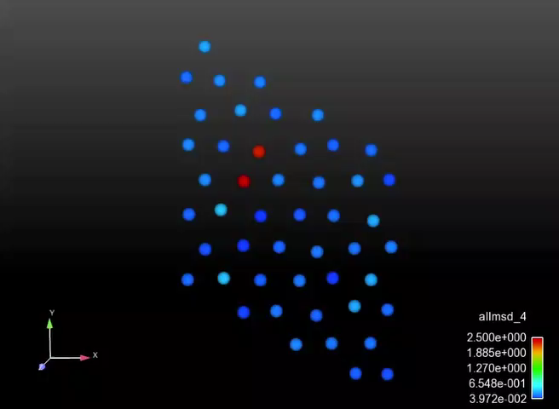

Understanding and Controlling the Crud Source Term in PWRs
Penghui Cao¹, Daniel Wells², Dennis Hussey², Michael Short¹
¹ Department of Nuclear Science and Engineering, MIT, USA
² Electric Power Research Institute (EPRI), Palo Alto, CA & Charlotte, NC, USA
LWRS Conference, Chicago, IL
August 2nd, 2016

Slide 2
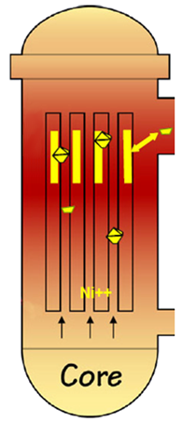
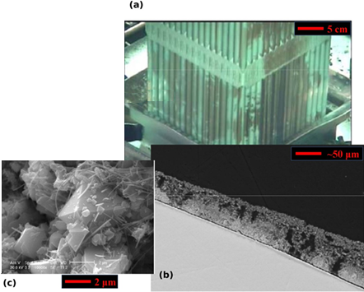
Goal: The Crud Source Term in PWRs
Corrosion products deposit as crud on fuel rods
To hot leg
Crud constituent phases
What about the crud source term?
Crud cross section showing typical structure
To cold leg
Short, M. P.,et al. MRS-B 39(1):71-77 (2014)
CASL phase I scope

Slide 3

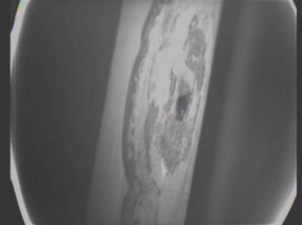
What Is Crud? Why Does It Matter?
Reactor fouling deposits: Causes operational problems like:
Axial downward power shift
Crud-induced localized corrosion
Core Height
Crud induced power shift
“Leaker” fuel failures
BO₃ Concentration
Power
Image: D. Gaston et al. Ann. Nucl. Ener., doi: 10.1016/j.anucene.2014.09.060 (2014)
Image: D. Wells. EPRI Summer P-TAC Meeting (2013)

Slide 4

First: An Overall System View
Where does Crud come/go in a PWR primary loop?
Hot Leg: 304SS, ~330C
Steam Generator: Alloy 600/690, 330C (Inlet) to 290C (Outlet)
Core: Contains fuel rods with sub-cooled boiling, removing particulates
Cold Leg: 304SS, ~290C

Slide 5
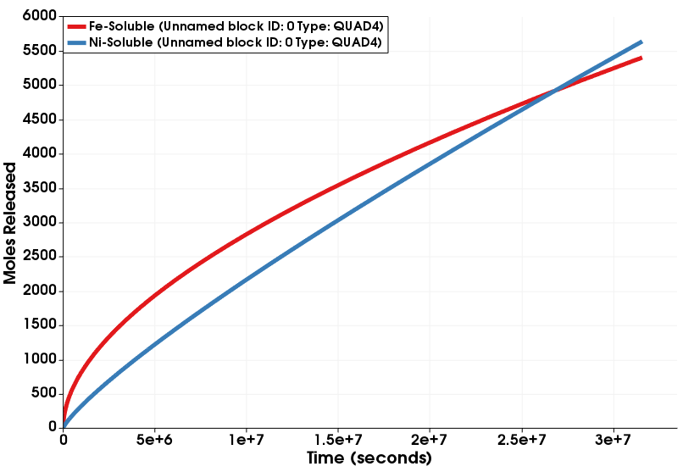
Engineering Scale: What Is Missing?
Ultimate goal: Predict the Ni & Fe metal release terms
Acts as source term for crud deposition codes (MAMBA¹, BOA²)
? ? ?
¹ Developed by CASL
² Developed by EPRI

Slide 6
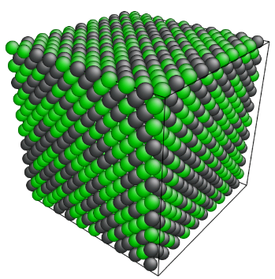
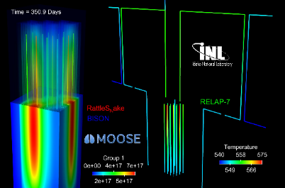
Delineating Scales and Interscale Communication
Calculate local Fe, Ni release rates
Molecular Dynamics (LAMMPS, Sandia)
E. Broitman, R. Becker et al. PRICM-8, 2013.
MOOSE MultiApps, Transfers, RELAP-7
MOOSE Mesoscale Oxidation, Diffusion Path Analysis
D. Gaston et al., INL Multiphysics Group, 2013.
Pre-computed diffusivity relations
Recalculate environmental conditions

Slide 7
Observations of Crud from PWRs
Mostly NiFe₂O₄ crystallites
Some NiO, Fe₃O₄
Source term appears to be particulate
Short, M. P.,et al. MRS-B 39(1):71-77 (2014)

Slide 8
Observations Become Justified Assumptions
All reactor internals create NiFe₂O₄ outer oxide crystals
Alloy 600 corrosion
Alloy 690 corrosion
Alloy 600 oxide film
P. Combrade et al. “Oxidation Of Ni Base Alloys In PWR Water: Oxide Layers And Associated Damage To The Base Metal.” Proceedings of the 12th International Conference on Environmental Degradation of Materials in Nuclear Power System – Water Reactors – Edited by T.R. Allen, P.J. King, and L. Nelson TMS (The Minerals, Metals & Materials Society), 2005

Slide 9
Assumption: NiFe₂O₄ Grows from Coolant
Data by P. Scott et al. show NiFe₂O₄ growth from solution
P. Scott, O. Calonne, and P. Combrade, “Study of Surface Remediation to Delay PWSCC Initiation in Alloy 600,” Unpublished EPRI project, 2007.

Slide 10
Assumption: Only the Innermost Oxide is Protective
Multiple studies confirm only innermost oxide slows down oxidation and metal release
Two phases identified:
Cr₂O₃
(Ni,Fe)Cr₂O₄
Cr₂O₃ often observed as “islands” (more to come…)
Graphical summary of observations of oxide phases formed on Ni-based alloys in PWR conditions
Graphical schematic of oxide layers formed on A600 after tens of thousands of hours of exposure in a PWR

Slide 11
Assumption: Water Ni/Fe Content Doesn’t Matter
BOREAL (PWR-like loop) testing shows little effect of Ni/Fe in coolant
F. Carrette. EDF-MAI Report H-B60-2008-01951-EN, p. 13 (2008).
Saturation levels around 1-5ppb

Slide 12

Key Assumptions: What (NOT) To Model
Low Ni,Fe High Ni,Fe
in coolant in coolant
Flow, Erosion
600 | 690 | 304
600 | 690 | 304
NiFe₂O₄
(Ni,Fe)(Cr,Fe)₂O₄
(Ni,Fe)Cr₂O₄
Cr₂O₃
Metal with (Cr,Ni) depletion zone
Base alloy
O
Fe
Cr
[1] [1] [1] [1] [2]
Diffusion/Transport
Missing diffusivity data
[1] T. Devine, ibid
[2] S Cisse et al. Corr. Sci., 56:209-216 (2012).

Slide 13
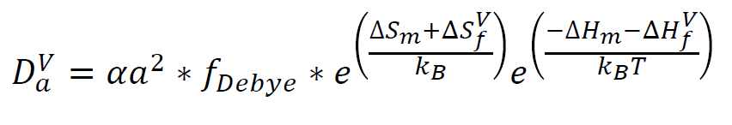
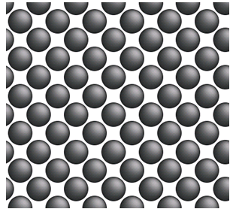
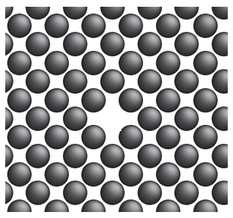
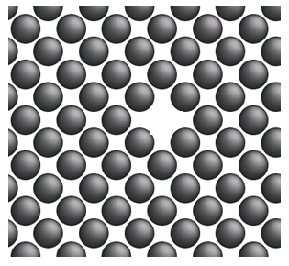
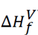
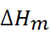
Computing Unknown Diffusivities
E_{A} or Q
D₀

Slide 14
Steps in Our Calculations
Choose potentials and parameters
Create unit cell with high defect density (speeds calculations)
Compute mean squared displacement (MSD) to get diffusion rates
Use nudged elastic band (NEB) method to find activation barriers (ΔH_{m})
Fit to experimental data (if available) to back out ΔH_{f} at real temperatures & defect concentrations

Slide 15
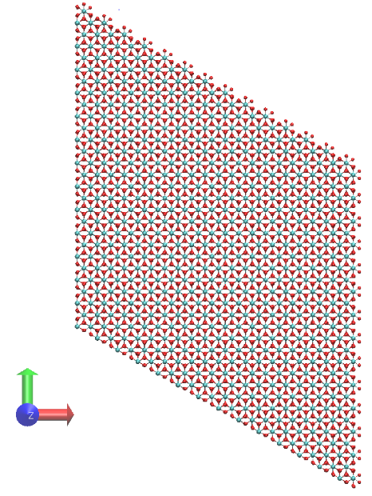
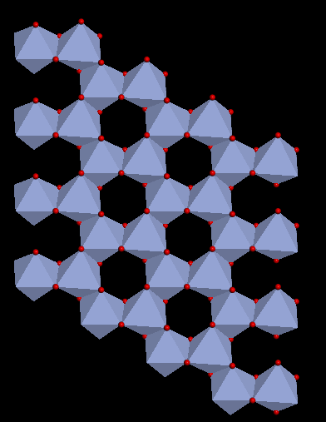
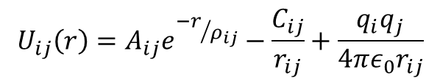
Computing Unknown Diffusivities: Cr₂O₃
Buckingham potential: Compensates charge loss due to ionic defects [1-2]
Model: 18x18x6 hexagonal unit cell with periodic boundary conditions, 58,320 atoms
$$U_{ij}\left(r\right)=A_{ij}e^{{−r}/{ρ_{ij}}}−\frac{C_{ij}}{r_{ij}}+\frac{q_{i}q_{j}}{4πε_{0}r_{ij}}$$
[1] R. Grimes. Phil. Mag. A, 72(3):651-668 (1995).
[2] Minervini et al., J. Mater. Chem., 10:2349-2354 (2000).

Slide 16
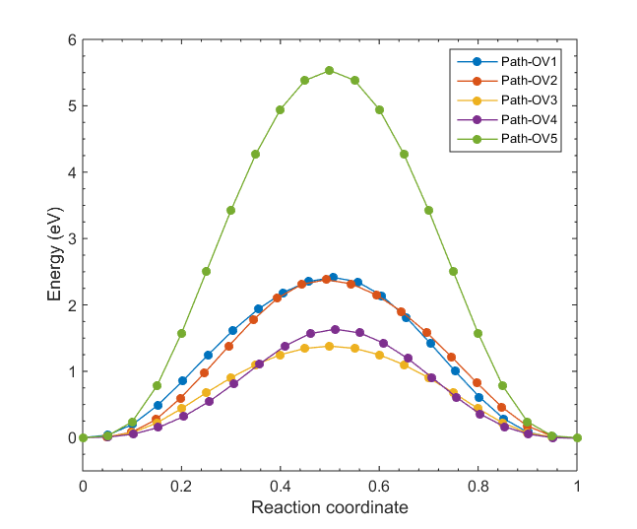
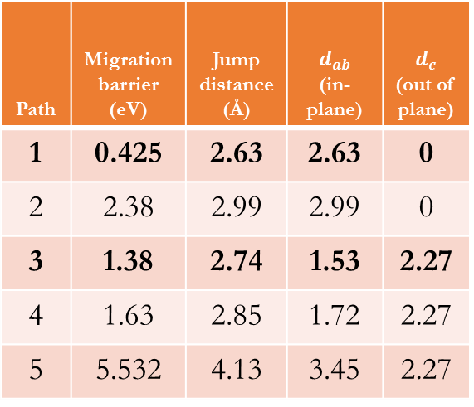
Computing Unknown Diffusivities: O in Cr₂O₃
Path 1
Path 2
Path 3
Path 4
Path 5
Path | Migration barrier (eV) | Jump distance (Å) | $$d_{ab}$$ (in-plane) | $d_{c}$ (out of plane)
1 | 0.425 | 2.63 | 2.63 | 0
2 | 2.38 | 2.99 | 2.99 | 0
3 | 1.38 | 2.74 | 1.53 | 2.27
4 | 1.63 | 2.85 | 1.72 | 2.27
5 | 5.532 | 4.13 | 3.45 | 2.27
In-plane diffusion
Out-of-plane

Slide 17
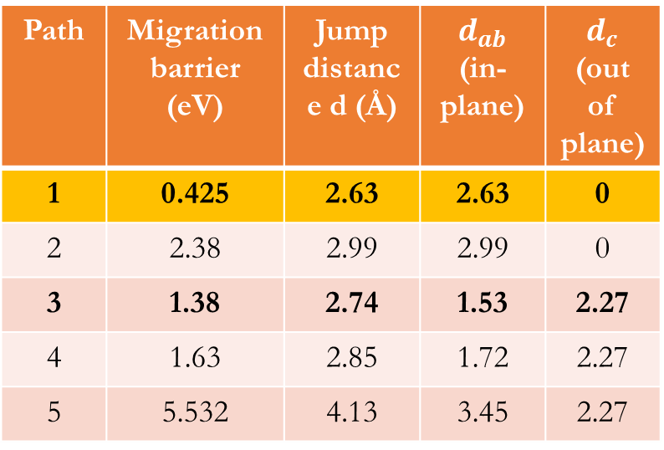
Watching Oxygen Diffusion Mechanisms
Path | Migration barrier (eV) | Jump distance d (Å) | $$d_{ab}$$ (in-plane) | $d_{c}$ (out of plane)
1 | 0.425 | 2.63 | 2.63 | 0
2 | 2.38 | 2.99 | 2.99 | 0
3 | 1.38 | 2.74 | 1.53 | 2.27
4 | 1.63 | 2.85 | 1.72 | 2.27
5 | 5.532 | 4.13 | 3.45 | 2.27
Atoms colored by displacement from original sites
What this means:
Oxygen diffuses mostly in-plane…

Slide 18
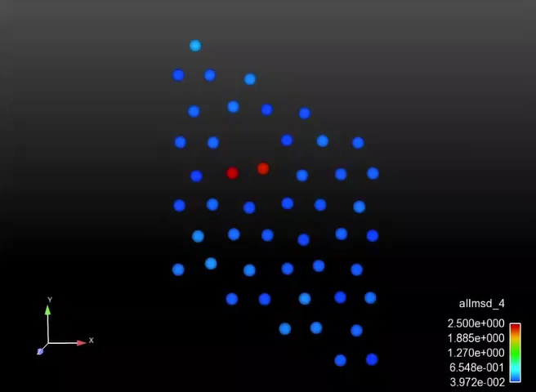
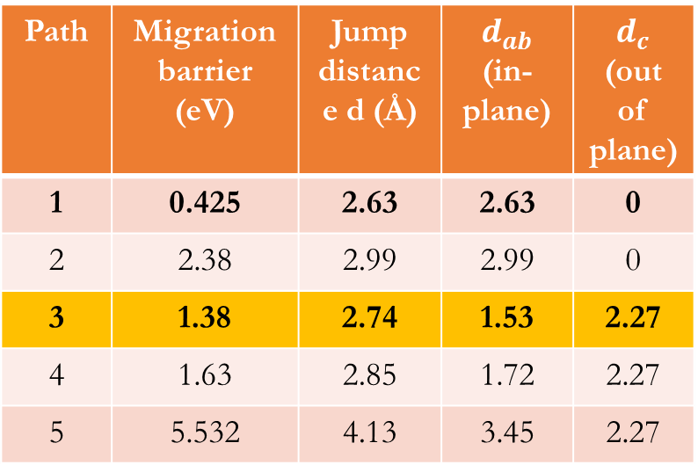
Watching Oxygen Diffusion Mechanisms
Path | Migration barrier (eV) | Jump distance d (Å) | $$d_{ab}$$ (in-plane) | $d_{c}$ (out of plane)
1 | 0.425 | 2.63 | 2.63 | 0
2 | 2.38 | 2.99 | 2.99 | 0
3 | 1.38 | 2.74 | 1.53 | 2.27
4 | 1.63 | 2.85 | 1.72 | 2.27
5 | 5.532 | 4.13 | 3.45 | 2.27
Atoms colored by displacement from original sites
What this means:
Oxygen diffuses mostly in-plane… but out-of-plane jumps do happen.

Slide 19
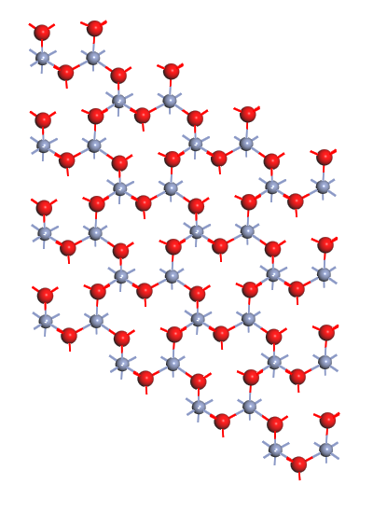
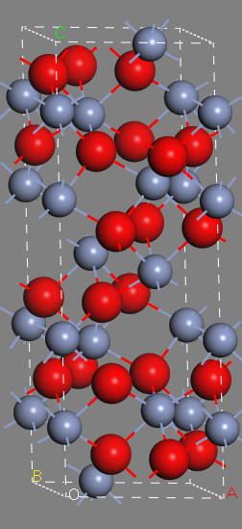
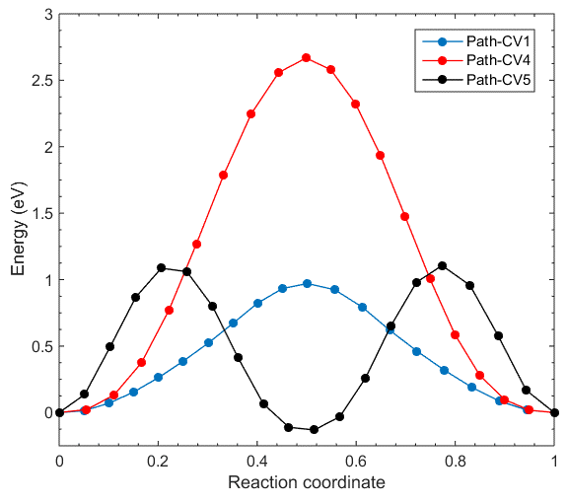
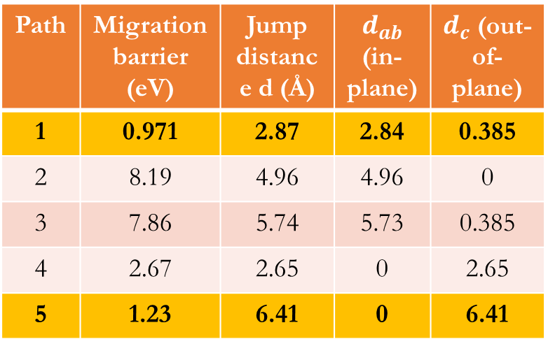
Unknown Diffusivities: Cr in Cr₂O₃
Path | Migration barrier (eV) | Jump distance d (Å) | $$d_{ab}$$ (in-plane) | $d_{c}$ (out-of-plane)
1 | 0.971 | 2.87 | 2.84 | 0.385
2 | 8.19 | 4.96 | 4.96 | 0
3 | 7.86 | 5.74 | 5.73 | 0.385
4 | 2.67 | 2.65 | 0 | 2.65
5 | 1.23 | 6.41 | 0 | 6.41
2
3
5
1
4

Slide 20
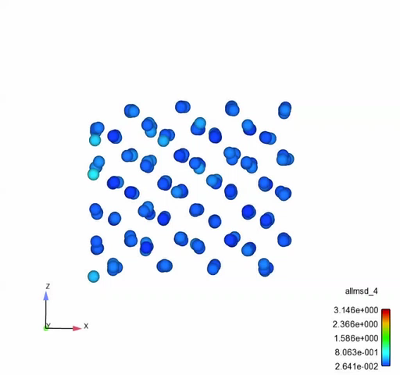
Watching Chromium Diffusion Mechanisms
2
3
5
1
4
What does this mean?
Cations migrate out-of-plane, which is very anisotropic.

Slide 21
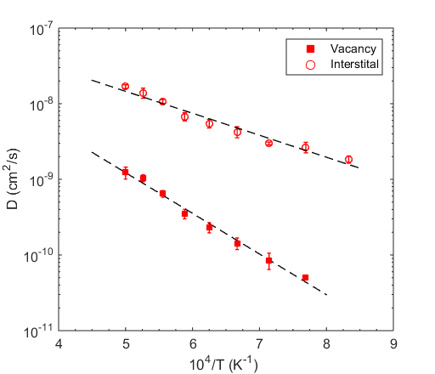
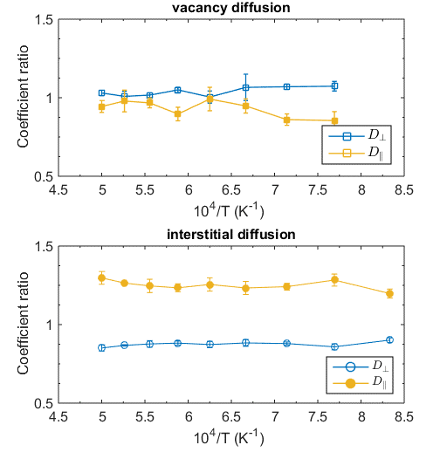
Full Cr₂O₃ Dataset for Oxygen
Anisotropic (factor of 2)

Slide 22
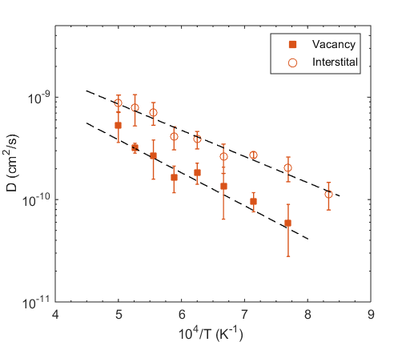
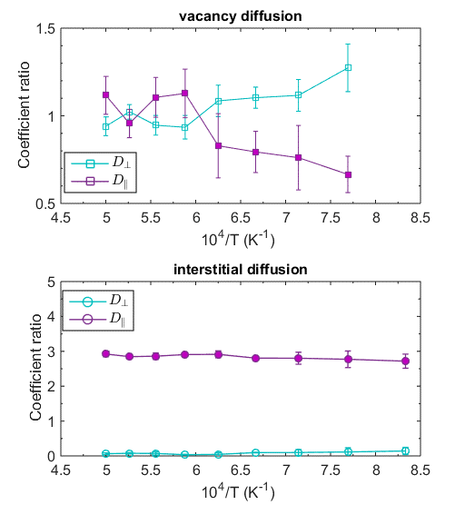
Full Cr₂O₃ Dataset for Chromium
Highly anisotropic (30x)

Slide 23
Comparison to Other Systems
Charged defect anisotropy is quite common in other systems
Long-range, anisotropic diffusion by hand-to-hand tetrahedral in La_{1-x}Ba_{1+x}GaO_{4x/2} by DFT
In-plane O diffusion by the vacancy mechanism, with oxygen ion density in red
E. Kendrick et al. Nat. Mater., 2007, 6, 871
A. Chroneos et al. J. Mater. Chem., 20:266-270 (2010)

Slide 24
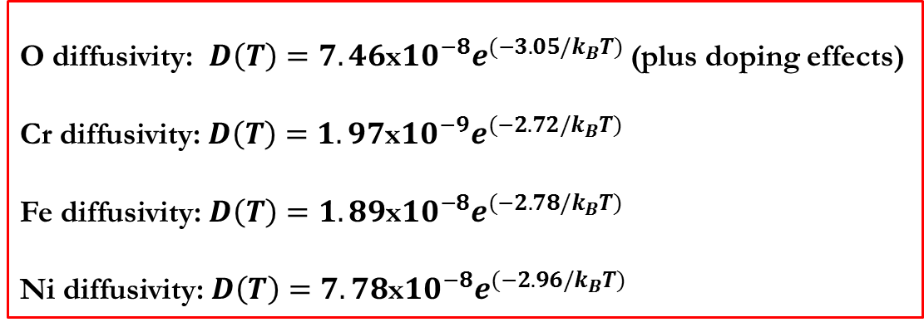
Diffusion Coefficients in Cr₂O₃
O diffusivity: $D\left(T\right)=7.46$x${10}^{−8}e^{(−3.05/k_{B}T)}$ (plus doping effects)
Cr diffusivity: $D\left(T\right)=1.97$x${10}^{−9}e^{(−2.72/k_{B}T)}$
Fe diffusivity: $D\left(T\right)=1.89$x${10}^{−8}e^{(−2.78/k_{B}T)}$
Ni diffusivity: $D\left(T\right)=7.78$x${10}^{−8}e^{(−2.96/k_{B}T)}$

Slide 25
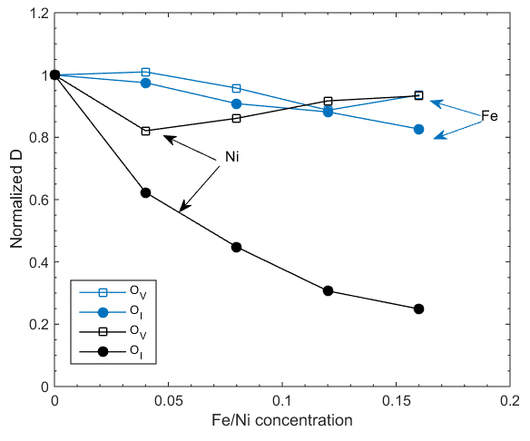
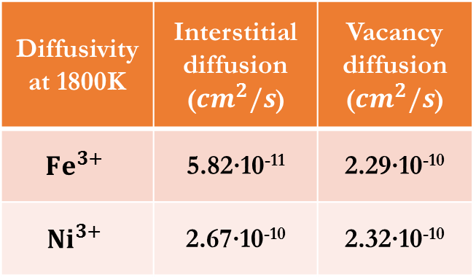
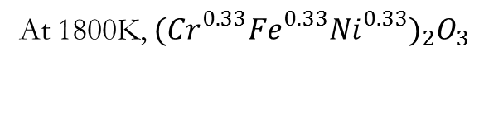
Effects of Dopant Cations
Ni slows oxygen diffusion more than Fe for both defects
At 1800K, ${({Cr}_{}^{0.33}{Fe}_{}^{0.33}{Ni}_{}^{0.33})}_{2}O_{3}$
Diffusivity at 1800K | Interstitial diffusion (${cm}^{2}/s$) | Vacancy diffusion (${cm}^{2}/s$)
$${Fe}^{3+}$$ | 5.82∙10⁻¹¹ | 2.29∙10⁻¹⁰
$${Ni}^{3+}$$ | 2.67∙10⁻¹⁰ | 2.32∙10⁻¹⁰

Slide 26
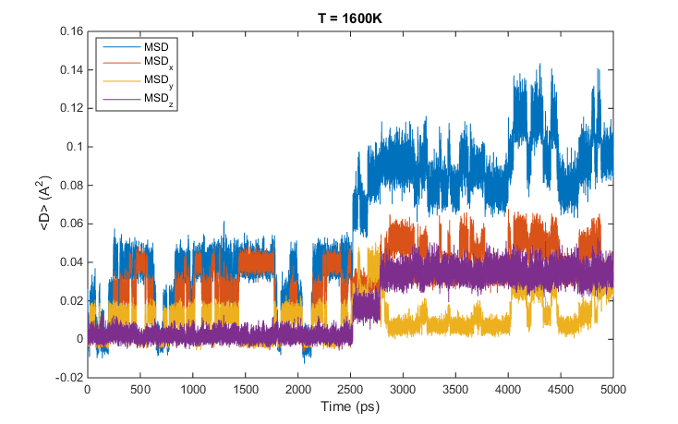
Comparison to Recent Work
Same diffusivities studied by MD in Cr₂O₃, different results
Path | H_{m} (eV)
1 | 0.971
J. Vaari. “Molecular dynamics simulations of vacancy diffusion in chromium(III) oxide, hematite, magnetite and chromite.” Solid State Ionics, 270:10-15 (2015).

Slide 27
Check Calculations with Experimental Data
Check computed MD Cr₂O₃ data with tracer diffusion experiments
E_{A} matches to within experimental error
D₀ differs by one order of magnitude (pretty good for MD)
Takeaway message: Our MD appears to be correct!
A. C. S. Sabioni et al. Mat. Sci. Eng. A, 392:254-261 (2005)
Our Fe diffusivity: $Db\left(T\right)=1.89$x${10}^{−8}e^{(−269 kJ/k_{B}T)}$ (1eV/atom = 96.85 kJ/mol)

Slide 28
Justifying Bulk Diffusion
(Our MD data)
SIMS data of Fe diffusion through polycrystalline Cr₂O₃
Grain size (nm)
GB width (~1nm)
A. C. S. Sabioni et al. Mat. Sci. Eng. A, 392:254-261 (2005)

Slide 29
The Spinel Diffusion Data, for Completeness
Key points:
Much lower activation energies, similar prefactors
Far faster diffusion predicted through spinel than Cr₂O₃
No tracer experiments to scale to! Major missing piece of data.
Diffusion in bulk Cr₂O₃
Diffusion in bulk (Ni,Fe)Cr₂O₄

Slide 30
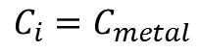
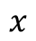
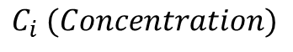
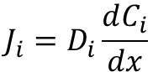
Feed Microscale into Engineering Scale
Microscale model computes Fickian flux, feeds areal release rate up to engineering scale
$$C_{i} (Concentration)$$
Prescribed thickness vs. time
A600, A690, SS304
$$J_{i}=D_{i}\frac{dC_{i}}{dx}$$
$$C_{i}=C_{metal}$$
$$x$$
Metal
Oxide

Slide 31
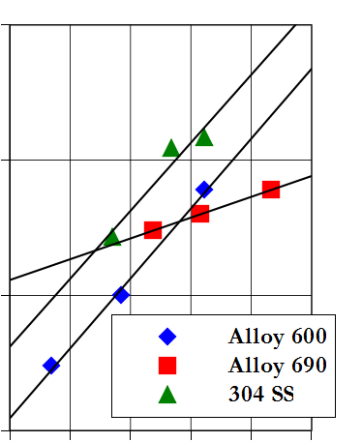
Microscale Model Assumptions: Oxide Thickness
Used experimental data from oxidation of A600, A690, 304SS at PWR conditions (units removed for proprietary concerns)
325-350C, 1200ppm H₃BO₃, 2ppm LiOH, pH ~ 7.2, 25-30 cc/kg H₂
A. Machet, A. Galtayries, S. Zanna, P. Jolivet, M. Foucault, P. Combrade, P. Scott, and P. Marcus, “Kinetics of passivation of a nickel-base alloy in high temperature water,” presented at the EUROCORR 2004, Nice (France), 2004.
Thickness
L. Guinard, C. Gabet, T. Czerwiec, E. Riquelme, and O. Kerrec, “Effect of surface passivation of Inconel 690 on oxidation in primary circuit conditions,” presented at the
Water Chemistry of Nuclear Reactor Systems 8, BNES, vol. 1, p. 67, 2000.
Program on Technology Innovation: Review of Oxidation and Surface Film Formation Studies
on Austenitic Alloys in Light Water Reactor Coolants. EPRI, Palo Alto, CA: 2015. 3002005478
Time

Slide 32
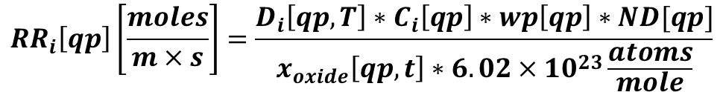
Putting it All Together
Compute local metal release rate at every location & time step
Diffusivities, oxide thicknesses are functions of space & time
Temperature profiles prescribed along loop, also functions of space & time
Our MD diffusivities
Concentration of species i in local metal
Local release rate
Quadrature point
Local wetted perimeter
$${RR}_{i}\left[qp\right]\left[\frac{moles}{m×s}\right]=\frac{D_{i}\left[qp,T\right]∗C_{i}\left[qp\right]∗wp\left[qp\right]∗ND[qp]}{x_{oxide}\left[qp,t\right]∗6.02×{10}^{23}\frac{atoms}{mole}}$$
Atomic number density
Species i (Fe or Ni for now)
Diffusion Flux (m²/s)
Prescribed oxide thickness vs. time & type
Avogadro’s number

Slide 33
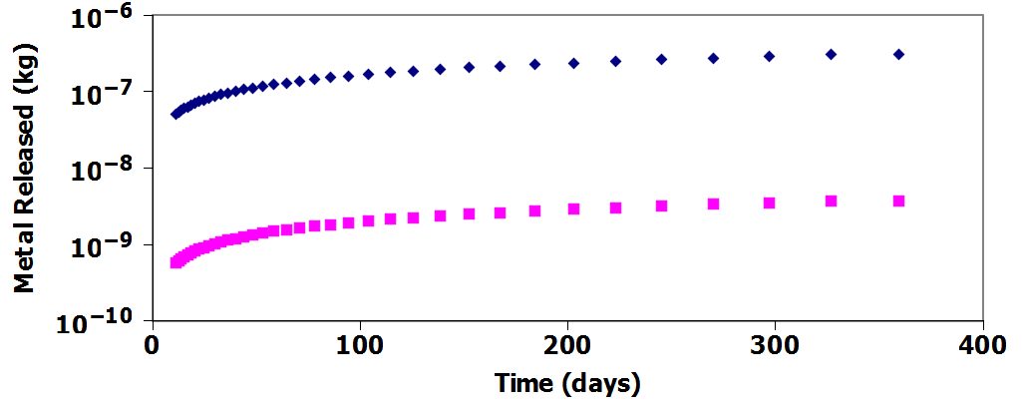
WEC 4-Loop PWR, A600, Cr₂O₃ Assumed
Fe
Key Points:
Slightly super- parabolic release rates (exponent >0.5)
WAY too little metal released: Further points to Cr₂O₃ being not fully protective in its actual state on SG tubes
“Islands” of Cr₂O₃ observed on Ni-based alloys are likely not fully formed, allow for fast diffusion in between
Ni

Slide 34
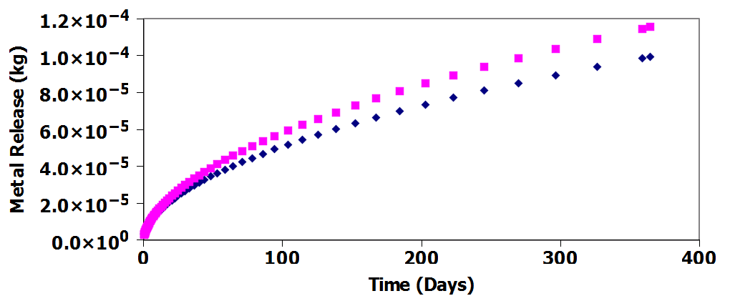
WEC 4-Loop PWR, A600, Spinel Assumed
Ni
Fe
Key Points:
Super- parabolic release rates
Ni/Fe ratio roughly unity in the first fuel cycle
~20kg total metal release, correct order of magnitude

Slide 35
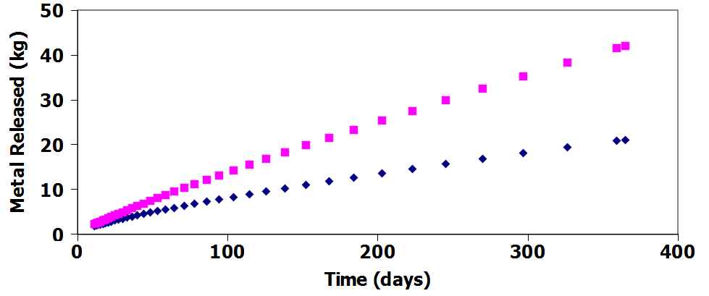
WEC 4-Loop PWR, A690, Spinel Assumed
Key Points:
Almost linear release rates!
Metal release is a pure function of oxide growth rates, plant geometry, and temperature for identical oxide phases
Ni/Fe ratio roughly two in the first cycle, should increase with time
~50kg total metal release, more crud predicted than for A600 plants
This is an artifact of the model, not reality. We can learn from it though…
Ni
Fe

Slide 36
What Can Integrated Predictions Tell Us?
MD Cr₂O₃ data is likely correct (with tracer validation)
Cr₂O₃ is likely not fully formed, though “islands” may be more complete in A690
Ni/Fe ratios on par with plant observations
A690 plants predicted to release more crud
Not consistent with existing measurements and data
Image: ANT International Crud in PWR/VVER coolant, p. 4-55 (2014)

Slide 37
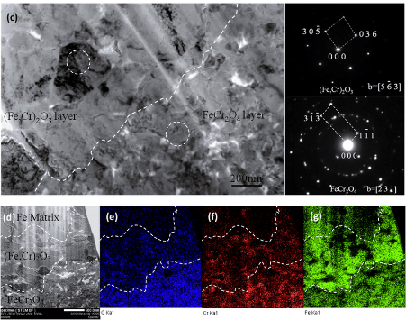
Major Data Gaps – Near Term Future Work
Tracer diffusion experiments for (Fe,Ni)Cr₂O₄ system
Needed to find ΔH_{f}
TEM analysis of SG tubes from autoclaves & plants
Phase identification often done using EDX, no phase info!
SIMS data of Fe diffusion through polycrystalline Cr₂O₃
Z X Xia et al. Sci. Rep., 5:13027 (2015)
A. C. S. Sabioni et al. Mat. Sci. Eng. A, 392:254-261 (2005)

Slide 38
Major Data Gaps – Near Term Future Work
R. Yang et al. J. Nucl. Sci. Technol., 43:9, 951-959 (2006)
Low-temperature, long-timescale MD simulations
Search for low-T fast diffusion
Check spinel off-stoichiometry diffusivities are representative
Crud from A690 plants
Must wait until fuel cycle 3 to account for historical crud
Schematic of the parallel replica dynamics method for accelerated MD simulations. A. Voter et al., Annu. Rev. Mater. Res. 32:321–46 (2002).

Slide 39

Thanks to Our Sponsor, Acknowledgments
This research was supported by:
P-TAC (PWR Technical Advisory Committee), contract numbers 10002739 and 10004433
Thanks to Kenny Epperson for accurate PWR segment lengths, wetted perimeters & areas

